Slide 1
PC Maintenance: Preparing for A+ Certification
Chapter 25: The Internet

Slide 2
Chapter 25 Objectives
Choose and set up an Internet connection method
Understand IP addressing and TCP/IP
Identify Internet protocols such as FTP, HTTP, and Telnet
Configure Internet Explorer
Configure Outlook Express
Troubleshoot Internet connections

Slide 3
What is the Internet?
Huge TCP/IP-based network
Physical mesh topology
Traffic passes through a complex system of routers
Addresses are translated between domain names and IP addresses by DNS servers

Slide 4
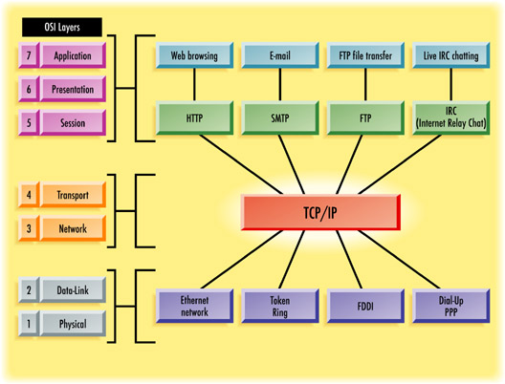
TCP/IP and the OSI Model

Slide 5
Ways to Connect to the Internet
Modem
ISDN
DSL
Cable
Satellite

Slide 6
IP Addresses on the Internet
A company has a range of IP addresses it can use on the Internet
Many times a company has more users than IP addresses available
Network Address Translation (NAT) is used to dynamically assign one of the available IP addresses as needed to a node

Slide 7
Static and Dynamic IP Addresses
Dynamic: Assigned by an ISP to an end-user; might change each time user connects
Static: Typically given to a server or other resource where the address must not change

Slide 8
Internet DNS Servers
Domain Name System
In example address www.emcp.com:
  Top-level DNS server translates the rightmost portion of the address (example: .com)
  Second-level DNS server translates next portion of the address (example: emcp)

Slide 9
TCP/IP Communication Protocols
IP addressing occurs at Network Layer (3)
TCP occurs at Transport Layer (4)
Session and Presentation layers can have different protocols in use such as:
  HTTP
  FTP
  Telnet
  E-mail protocols

Slide 10
Common Layer 5 and 6 Protocols
Hypertext Transfer Protocol (HTTP)
  Used to deliver Web content to a Web browser application
File Transfer Protocol (FTP)
  Used to upload and download files
  HTTP can also download files, but FTP is more efficient
Telnet
  An old protocol for terminal emulation

Slide 11
E-mail Protocols
Post Office Protocol (POP, or POP3)
  Used for receiving e-mail with an e-mail application such as Outlook
  Retrieves messages from the server and deletes them from the server

Slide 12
E-mail Protocols
Internet Message Access Protocol (IMAP)
  Used for receiving e-mail with either an e-mail application or an IMAP-enabled Web interface
  Messages remain stored on the server
  Useful for people who access their mail from multiple locations

Slide 13
E-mail Protocols
Simple Mail Transfer Protocol (SMTP)
  Used for sending e-mail (not receiving)
Hypertext Transfer Protocol
  Used for Web-based e-mail applications such as Hotmail and Yahoo Mail

Slide 14
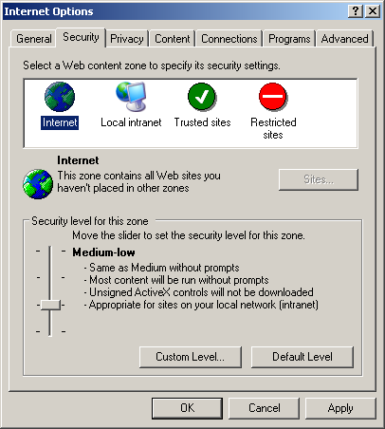
Security Preferences in Internet Explorer
Choose Tools > Internet Options and click the Security tab
Drag the slider to change the security level for the selected zone

Slide 15
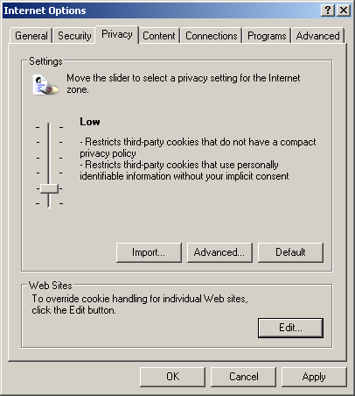
Privacy Preferences in Internet Explorer
Choose Tools > Internet Options and click the Privacy tab
Control the usage of cookies
Set certain Web sites to always or never be allowed to use cookies

Slide 16
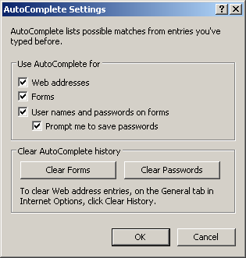
Privacy Preferences in Internet Explorer
Turning off AutoComplete can give greater privacy
Turn it on/off from Content tab of Internet Options dialog box

Slide 17
Outlook Express
Default mail application in Windows
Sends and receives e-mail
Views and posts to USENET newsgroups
Each Windows version comes with a different version of Outlook Express
Windows 95 came with Internet Mail and Internet News instead

Slide 18
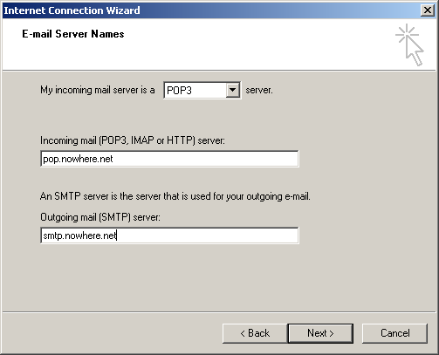
Setting Up an E-mail Account
In OE, choose Tools > Accounts
Click Add, then click Mail
Follow the prompts in the Internet Connection Wizard

Slide 19
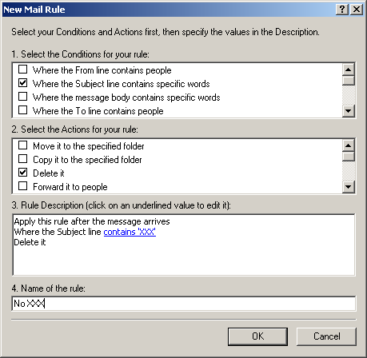
Filtering Out Junk Mail
In OE, choose Tools > Message Rules > Mail
Create a new Mail Rule

Slide 20
Transferring Files with FTP
Stand-alone FTP application
  Many shareware and trial versions available
FTP through Internet Explorer
  Usually download only
Command-line FTP access
  Can be difficult to memorize command syntax

Slide 21
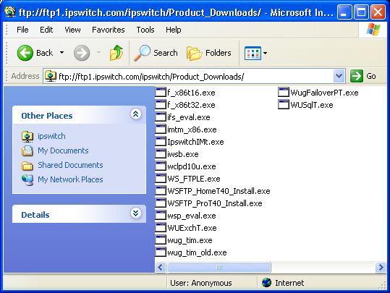
FTP through Internet Explorer

Slide 22
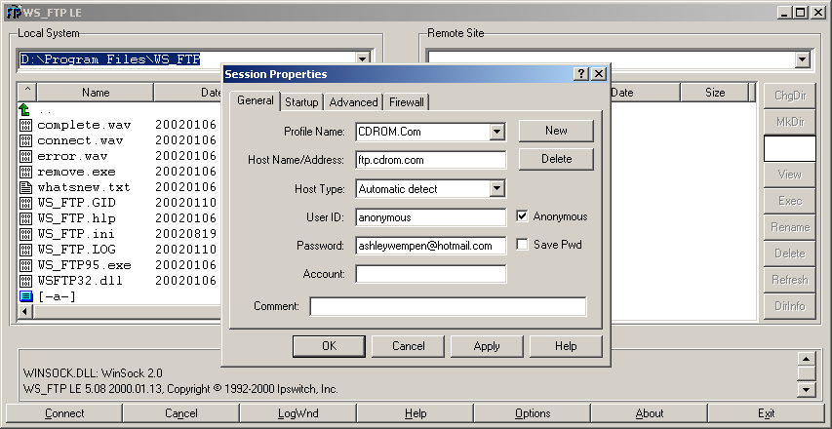
FTP through an FTP Application

Slide 23
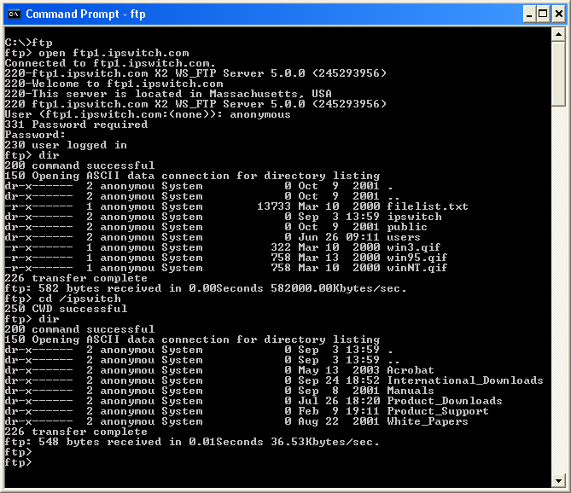
FTP through a Command Line

Slide 24
Sharing an Internet Connection
Cable/DSL Router
Internet Connection Sharing
  Windows 98 Second Edition
  Windows Me
  Windows XP

Slide 25
Troubleshooting Internet Problems
No Web, No E-mail
  Check connectivity
  Reset terminal adapter
  Reboot PC
  Use ping to check a well-known site

Slide 26
Troubleshooting Internet Problems
Web but No E-mail
  Mail account might not be set up correctly
  Mail server might temporarily be down
E-mail but No Web
  Try bypassing proxy server if possible (from Connection tab of Internet Options)
No Access to Specific Web Site
  Ping
  Tracert

